Slide 1
Predicting Customer Churn for Abuja Electricity Distribution Company (AEDC)
Identify customers likely to stop using the Abuja Electricity Distribution Company and Develop Proactive Retention Strategies.
Mentee Name: Bwatna Kuyembo
Mentor’s Name: Mr Isreal Odeajo
Group Name: 3MTT C2 Data Science (116)
April 2026

Slide 2
It is a Tuesday morning in Garki District II, Abuja. Mr. Emeka Okonkwo, a small business owner running a tailoring shop on Ahmadu Bello Way, has just received his third consecutive electricity bill that feels grossly inflated. Load-shedding cut his work hours by 40% last month, yet his bill shows no reduction. He calls the AEDC customer care line - it rings unanswered for 11 minutes. That evening, he walks into a neighbour's compound and notices the glowing hum of a 10 kVA generator. A week later, Emeka purchases his own. He applies for a "low-usage" tariff review, hears nothing, and quietly disconnects his AEDC meter. He is now a churned customer.
Across the FCT - in Wuse Market stalls, Lugbe residential apartments, and Kubwa satellite towns - hundreds of Emekas make the same calculation every quarter. They switch to diesel generators, solar inverter systems, or simply go off-grid. AEDC loses not just revenue from those connections but also the compounding effect of infrastructure investment that can never be recouped from a shrinking customer base.
The Churn Prediction team at AEDC's Analytics Centre in Central Business District is handed a challenge: can we identify which customers are about to leave - before they leave? They have 18 months of billing records, complaint logs, outage incidents, tariff-class data, and demographic signals. The goal is a machine-learning model that flags at-risk customers early enough for the Retention Team to intervene - a targeted discount, a proactive callback, a meter inspection, or a genuine bill correction.

Slide 3
Problem statement
This project focuses on predicting customer churn using AEDC customer transaction and service experience data. The dataset contains customer demographic information, billing and transaction details, energy consumption, service usage, outage frequency and duration, complaint frequency, satisfaction scores, and debt/arrears history.
IMPORTANCE OF THE PROJECT
Electricity is essential for economic growth
Overbilling and inefficient usage drain household income
Smart tracking leads to better budgeting and cost savings

Slide 4
Project Overview
The project builds a machine learning system that predicts which electricity customers in Abuja are likely to stop using AEDC's service (churn) - before they actually leave. This gives AEDC's retention team a warning to intervene with targeted offers, debt restructuring plans, or service improvements.
The goal is to use data science and machine learning techniques to:
build a predictive model that identifies customers at risk of leaving,
Recommend proactive retention strategies based on model insights.
understand key drivers of customer churn,
Solution
The project turns 2,500 rows of billing data into a deployable early-warning system. The Random Forest model can score every active AEDC customer at each billing cycle, flag those above a 0.35 churn probability threshold, and route them to the retention team - converting a reactive problem into a proactive one.

Slide 5
Data Cleaning and Preprocessing
Checking the dataset structure, column names, and data types
Handling missing values: The single column with missing values is Token (1,242 nulls — 49.7%). This is a structural absence: Postpaid meter customers do not receive prepayment tokens by definition. We treat this as informative and fill it symbolically. This is a clean dataset, unusually so for utility billing data.
Checking and removing duplicate records: which we didn’t have.
Converting Transaction_DateTime into datetime format to enable time-series analysis.

Slide 6
Data Description
The dataset is a realistic synthetic dataset representing AEDC customer records in Abuja with 2,500 rows and 33 columns.
Features include: monthly_bill_amount, outage_frequency, complaint_count, tariff_class, payment_delay_days, tenure_months, meter_type, energy_consumption_kwh.
Target Variable : churn_status (1 = churned, 0 = retained).
Acquiring a new electricity customer costs AEDC approximately ₦45,000–₦80,000 in meter installation, inspection, and administrative overhead. Retaining an existing customer through a targeted intervention — a service visit, a corrected bill, or a tariff renegotiation — costs an average of ₦3,500–₦8,000. A model that prevents even 500 churns per quarter saves the business between ₦18.25M and ₦36M annually in acquisition replacement costs alone, excluding the lost revenue stream during the gap period.

Slide 7
Tools and Technologies
Programming Language: Python
Development Environment / IDE Jupyter Notebook
Data Handling and Manipulation Libraries Pandas
Data Visualization Libraries Matplotlib Used for plotting graphs such as churn distribution, histograms, and ROC curves. Seaborn Used for advanced statistical visualization such as heatmaps and feature relationship plots.
Machine Learning Libraries Scikit-learn (sklearn)Core library used for: train-test splitting scaling (Standard Scaler)model training (Logistic Regression, Random Forest)model evaluation (confusion matrix, classification report, ROC-AUC, ) hyperparameter tuning (GridSearchCV)cross-validation (StratifiedKFold)
Handling Class Imbalance Imbalanced-learn (imblearn)Used to solve class imbalance with techniques like: SMOTE (Synthetic Minority Oversampling Technique) SMOTETomekPipeline integration for balanced training without data leakage
Frameworks Scikit-learn Framework Used as the main machine learning framework for training, evaluation, and deployment-ready modeling pipelines.
Model Types Used: Logistic Regression, Random Forest Classifier
Evaluation Metrics Used: Classification Report (Precision, Recall, F1-score, Confusion Matrix, ROC Curve, AUC Score (Area Under Curve)

Slide 8
Model Development Algorithms used: Logistic Regression Random Forest
Model Evaluation Metrics
Accuracy
Precision
Recall (Sensitivity)
F1-score
ROC-AUC Curve
Confusion Matrix

Slide 9
Methodology
The project followed a structured Data Science workflow:
1. Data loading and inspection
2. Data cleaning and missing value handling (median for numeric, mode for categorical)
3. Exploratory Data Analysis (EDA) with visualizations
4. Feature engineering (margin, subscribed power, churn encoding, date extraction)
5. Model training using Logistic Regression and Random Forest
6. Model evaluation using accuracy, confusion matrix, classification report, and ROC-AUC
7. Business recommendations and churn retention strategy development

Slide 10
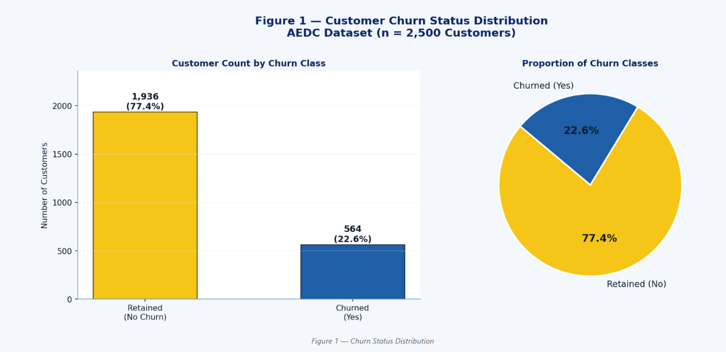
Exploratory Data Analysis (EDA) What it shows: No 1,936 customers are retained (77.4%) and Yes 564 have churned (22.6%) - an imbalance ratio of approximately 3.4:1. Business implication: This imbalance means a naive model that predicts "No churn" for every customer would achieve 77.4% accuracy while being completely useless. We must correct for this before training. From a business standpoint, each churning customer represents lost revenue - understanding the 22.6% is far more valuable than perfecting predictions on the 77.4% who stay. Action: We will apply SMOTETomek to balance the training data before model fitting.

Slide 11
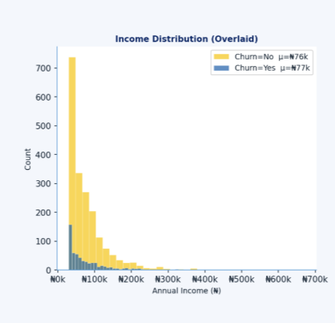
Income Distribution of AEDC Customer What it shows: Retained customers have a mean income of ₦76,354 versus ₦76,580 for churned customers. Business implication: Income alone does not predict churn at AEDC. customers across the income spectrum churn at similar rates. Churn is therefore not a low-income affordability problem, it is a service quality and billing problem. Retention strategies should not be targeted by income bracket; they should focus on service experience. AEDC should not offer income-based discounts as the primary retention lever.

Slide 12
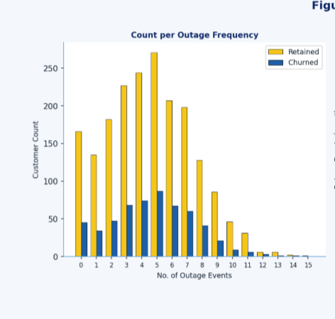
Power Outage Frequency Distribution What it shows: Mean outage frequency is 4.61 for retained and 4.65 for churned - nearly identical. The bar chart confirms no meaningful difference across all frequency levels. Business implication (counterintuitive): Simply experiencing power outages does not reliably cause churn on its own. All AEDC customers experience frequent outages - it is a market-wide condition. What matters is how AEDC responds to those outages. If outages are followed by quick resolution, transparent communication, and accurate billing, customers tolerate them. If outages are accompanied by unexplained billing spikes or long resolution times, that combination triggers churn. AEDC should pair outage-tracking with response-quality metrics.

Slide 13
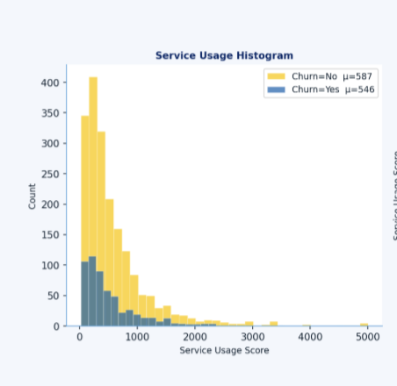
Service Usage by churn status What it shows: Retained customers have higher median service usage (₦382) compared to churned customers (₦361). Business implication: Low service usage is a strong early-warning indicator. Customers who are progressively reducing their electricity consumption - likely substituting AEDC with a generator or solar system - display declining usage months before they formally disconnect. AEDC should implement a "usage velocity" alert: if a customer's consumption drops by 20% or more over two consecutive billing cycles, they should be automatically flagged for a proactive retention call. The time to intervene is while they are still a customer, not after disconnection.

Slide 14
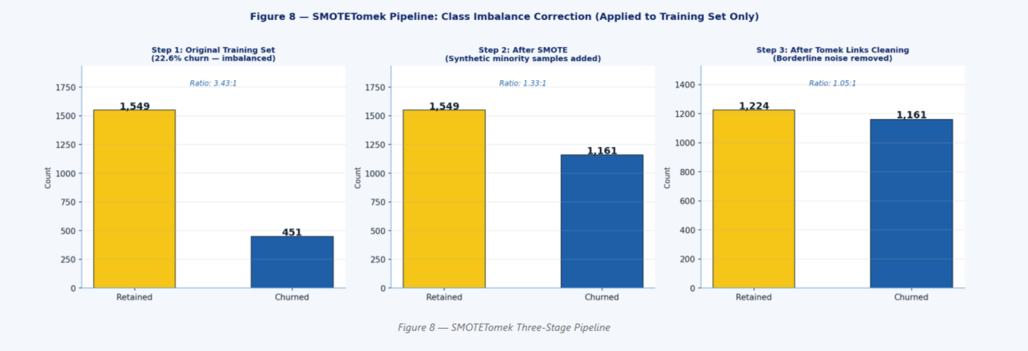
Class Imbalance: SMOTETomek Correction Why imbalance matters · SMOTE oversampling · Tomek Links cleaning · Applied to training set only. The dataset has a 3.4:1 imbalance (77.4% retained vs 22.6% churned). While not extreme, this is sufficient to cause classifiers to underperform on the minority class - which is precisely the class we need to predict. We implement SMOTETomek: a two-stage pipeline that first creates synthetic minority samples (SMOTE), then removes borderline majority samples that contaminate the decision boundary (Tomek Links).

Slide 15
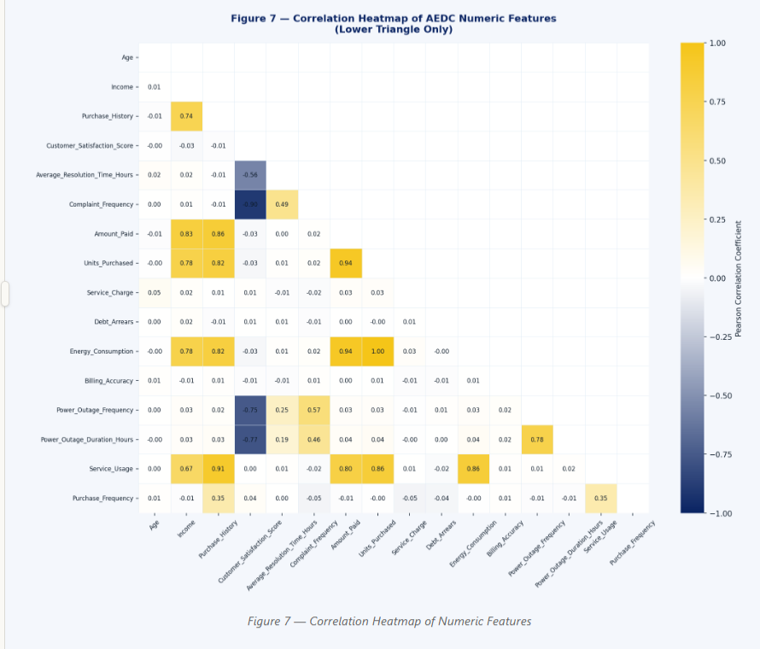
Correlation Heatmap of AEDC Numeric Features Strong positive correlations (yellow, close to +1.0): • Amount_Paid -VAT - Service_Charge (r ≈ 0.95+): These billing components are formulaically derived from Amount_Paid. They carry redundant information - including all three in the model would introduce multicollinearity for Logistic Regression. We keep Amount_Paid as the primary billing signal. • Energy_Consumption - Units_Purchased (r ≈ 0.99): Essentially the same measurement. We keep Units_Purchased and derive a Cost_Per_KWh feature. • Debt_Arrears - Debt_To_Income: Debt is the single most important churn driver in this dataset. The feature engineering section creates a Debt_To_Income ratio to normalise this signal across income levels. Weak correlations (dark blue, near zero): Age, Power_Outage_Frequency, and Billing_Accuracy show near-zero correlations with most other features - they contribute independent information and should be retained.

Slide 16
Key feature engineering decisions
Outage_Burden = Frequency × Duration: A customer who experiences 10 short outages is differently affected than one who experiences 2 outages of 15 hours each. The product captures this compounding effect — the total hours of darkness experienced.
Debt_To_Income: A ₦40,000 debt arrear means very different things to a ₦30,000/month earner versus a ₦200,000/month earner. Normalising by income makes this feature meaningful across the income spectrum. This turned out to be the strongest predictor of churn in our dataset (see Feature Importance, Section 6).
Sat_Complaint_Ratio: A customer can have high complaints AND high satisfaction (resolution quality is good). This ratio differentiates those two patterns — a customer with 5 complaints but satisfaction score of 4.8 is actually well-served; one with 2 complaints and satisfaction 1.2 is at risk.

Slide 17
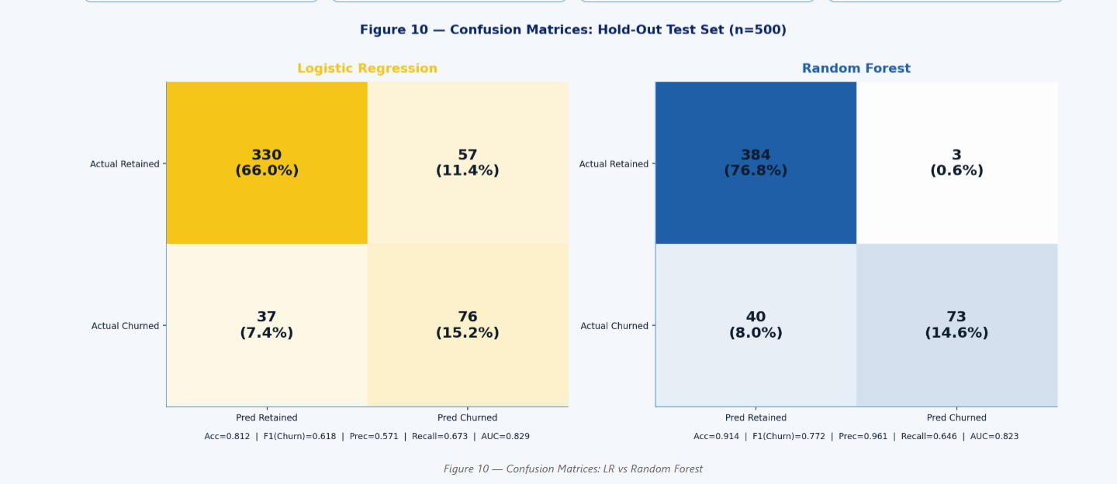
Confusion Matrices for AEDC: • LR: True Positives = 76 churned customers correctly identified; 37 missed (False Negatives). 57 false alarms (customers predicted to churn who stayed). For the retention team this means: call 133 people to save 76 real churners — a 57% hit rate. • RF: True Positives = 73 correctly identified churners; 40 missed. Only 3 false alarms. Hit rate of 96.1%. The RF is highly precise — nearly every customer it flags as churn-risk is a genuine churner. This is more efficient for the retention team, but the lower recall (64.6% vs LR's 67.3%) means 40 churners go undetected. Business decision: If retention resources are abundant, use LR's higher recall (catch more churners). If retention resources are scarce and expensive, use RF's higher precision (don't waste calls on false alarms). For AEDC, we recommend using RF probabilities with a lowered threshold of 0.35 to increase recall while preserving most of RF's precision advantage.

Slide 18
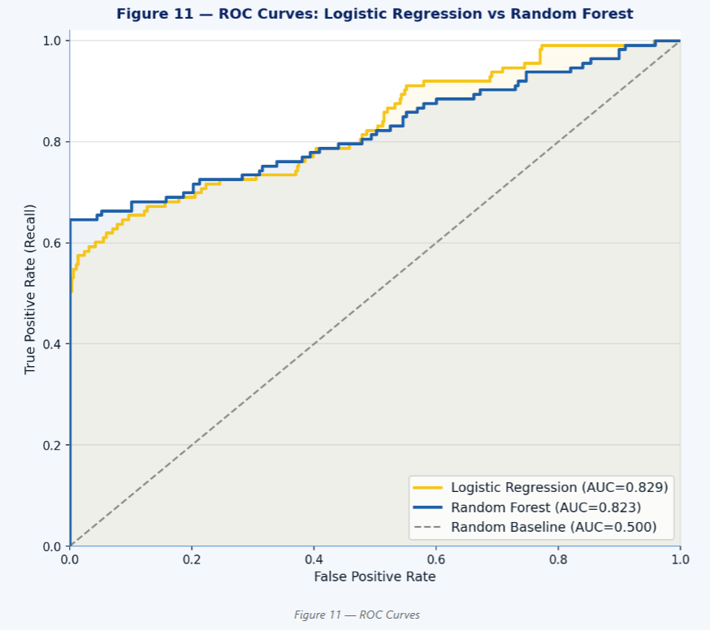
ROC Curves: logistic Regression and Random Forest The ROC curve plots True Positive Rate (catching churners) against False Positive Rate (false alarms) at every possible probability threshold. The AUC (Area Under Curve) summarises the overall discriminative ability. • LR AUC = 0.829: A randomly selected churned customer scores higher than a randomly selected retained customer 82.9% of the time. Strong performance. • RF AUC = 0.823: Similar overall discrimination. The ROC curves actually cross — RF dominates at high precision (low FPR) while LR is competitive at high recall settings. Deployment recommendation: Use RF as the primary scoring engine with threshold = 0.35 for balanced recall/precision. Run LR in shadow mode for explainability and regulatory reporting.

Slide 19
Final Recommendation to AEDC Management
Deploy Random Forest as the primary churn predictor, scoring all active customers monthly (or weekly during billing cycles). Customers with predicted churn probability ≥ 0.55 enter the "at-risk queue" for the Retention Team. Customers above 0.80 probability are escalated to senior retention officers with authority to offer tariff adjustments.
Keep Logistic Regression as a shadow model for regulatory reporting and explainability. When a customer appeals a retention outreach, AEDC can produce a printable LR-based score card with plain English explanations: "Your account was flagged because of 5 unresolved complaints in the last 60 days and a 23-day payment delay on your last bill."
Together, these two models give AEDC both the performance to catch churning customers and the transparency to explain why — a combination required for responsible AI deployment in a regulated utility environment.
Churn is strongly influenced by arrears, outage duration, and slow complaint resolution
Customers are leaving not just due to pricing, but due to trust and service experience
The churn prediction model helps AEDC identify customers before they leave .

